Slide 1


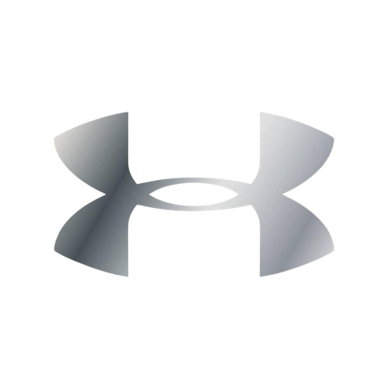

Under Armour
Despina Kappas
Ethan Ashton
Henry Chollick
Ian Bullette

Slide 2

01
Market Analysis
02
Strategy Analysis
03
Focus Group Description
04
Focus Group Key Findings
05
Recommendations
Agenda
06
Conclusions

Slide 3


Company
  Founded in 1996 by Kevin Plank in Baltimore
  Built around the first moisture-wicking compression shirt
  Grew through NFL partnerships in the 1990s-2000s
  Main products are performance apparel, athletic footwear, and accessories
  Revenue dropped 9.1% in in fiscal year 2025 after peaking at a $5.9 billion valuation in 2023

Slide 4
Customers
  Primary customers are performance-driven athletes
    UA calls them “athletes” to build identity and loyalty
  Men are the strongest segment
    Women and youth are growing areas but do not have the same success
  Some consumers can’t justify UA's price relative to their designs and perceived quality

Slide 5


Conditions
ECONOMIC
TECHNOLOGICAL
SOCIAL
POLITICAL
By 2028, over half of U.S. digital buyers are projected to purchase apparel through social media. Seamless in-platform buying is critical for the future.
84% of active consumers are exercising as much or more than the prior year. 51% of active consumers say fitness is essential to their identity. Brand clarity matters more than ever
Inflation has made consumers more price-sensitive, making preferences shift towards durable, quality products.
Global trade uncertainty and tariffs risk passing costs to consumers.

Slide 6

Direct Competitors
Indirect Competitors
  Nike
    Globally recognized, appeal across both genders, dominant in lifestyle and performance
  Adidas
    Strong brand value, globally recognized
  Lululemon
    Leads in women’s athletic wear, lifestyle oriented
  Converse, Fruit of the Loom, Sketchers
    Compete for casual athletic and everyday apparel spending without directly targeting the performance segment

Slide 7
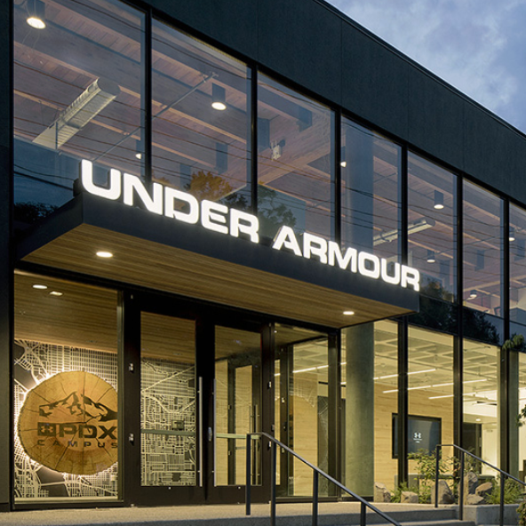
Strategy
Analysis
Perception
Memory and Learning
Motivation
UA’s visuals include dark gyms, slow motion, dramatic music, and more features that show how serious the brand is. For someone who lives and breathes athletics, it reads great. But for everyone else, it reads as "This isn’t for you." Focus group participants said, "It's only for people who are serious about the gym. It drives you away from buying UA.”
UA has done the conditioning work. Participants across both focus groups could recall Steph Curry and Dwayne Johnson without any prompting. The problem is what it’s been conditioned to mean. Grit, intensity, and not much else. Participants have been using MapMyRun and MyFitnessPal apps for years but didn’t know UA was behind it.
UA is selling the feeling of becoming someone better, and that’s a powerful idea. The issue is that the way they sell it makes people turn away. You see a UA ad, and the message isn’t “you could be this"; it’s "You're probably not this.” People want to improve, but avoidance kicks in because the brand feels like it lknows who its for.

Slide 8
Strategy
Analysis
Attitude
Self-concept
Subculture
For serious athletes, UA works. They watch an ad, they believe the product works, and they buy it. For anyone that isn’t a serious athlete, the ads don’t build a positive feeling. UA sets expectations through the lens of top-performing athletes, and when the product doesn’t make you feel like that, it creates distance.
UA is speaking entirely to who you want to be, not who you are. UA has stretched the gap so far that it stops feeling like motivation and starts to feel like rejection, and it showed in our focus groups. The person they pictured wearing UA isn’t someone they want to be friends with. It was someone they didn’t want to be seen as.
UA belongs to a specific American sports subculture. Football locker rooms, competitive basketball, and intense training. Outside of that world, it barely exists. Nike and Lululemon figured out how to live inside of multiple subcultures at once without losing their identiy. UA needs to fill that gap.

Slide 9


Group 1: Upperclassmen
  Sessions covered brand recall
  word association
  ad reaction
  brand personification
  concept testing
  Tested mock campaigns: "The 22 Hours" and "Joy in Motion" sub-brand concept​
  Formed identities
  Stronger brand loyalty
  More experience & experience-driven decisions
  Already established brand loyalties
Group 2: Underclassmen
  High trend sensitivity
  Opinions shaped by social media & peer norms
  Parents still influential​ on decisions
Focus Group Description

Slide 10
Focus Group Key Findings
Upperclassmen
Underclassmen
1
2
FOCUS GROUP 1 PARTICIPANT — BRAND PERCEPTION
“ All of their stuff looks so middle school to me”
FOCUS GROUP 2 — WORD ASSOCIATION EXERCISE
"Middle school, neon, ugly, boring, outdated."
Upperclassmen
Underclassmen
1
2
FOCUS GROUP 1 — SOCIAL RISK
"I feel like I never see anyone wearing Under Armour. So I would be insecure."
FOCUS GROUP 2 — AD REACTION: STEPH CURRY
"It's only for people who are serious about the gym. It drives you away from buying Under Armour."
1
Upperclassmen
Underclassmen
2
FOCUS GROUP 1 — AD REACTION: PROTECT THIS HOUSE
"Those are the most cringe ads I've ever seen in my life."
LIFESTYLE VS. SPECIALIZED TOOL
"specialized tool unless you're like a fifth grader, then you're rocking that sh*t all the time."

Slide 11

Recommendations
22-Hour Campaign
Our 22- hour’s campaign is meant to focus on UA as a lifestyle brand and help dissociate from a specialized/ workout brand. While bringing in a larger female audience, while retaining its male audience.
Focus group reactions:
  “It's not as cringe” (FG 1)
  “It's just someone with their dog... It's like now it's like a lifestyle brand" (FG 1)
  “Yeah, chill., Like that's lifestyle” (FG 2)
  “Yeah it's like a positive vibe” (FG 2)

Slide 12
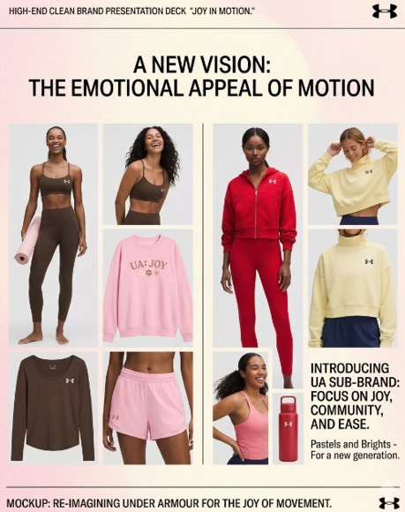
Recommendations
Joy In Motion
This campaign was meant to enforce the lifestyle and everyday clothing aspect that we are bringing to UA. By bringing in trending and seasonal colors, we are opening the market to appeal to younger generations as well as a female audience, which is what UA is currently lacking.
Focus group reactions:
  "I'd buy it." (FG 1)
  “It feels like it actually cares about what women want to buy." (FG 1)
  “ I like color and it's giving girl” (FG 2)

Slide 13
Strengths and Weaknesses
Strengths
Weaknesses
PRODUCT QUALITY & DURABILITY
BRAND AWARENESS
ADVERTISING FAILURE
GENDER SKEW
  Participants who purchased UA consistently reported satisfaction.. Durability is a real, defensible asset
  "I've had mine since I was like 15 so it's lasted a long time." (FG 1)
  86% brand awareness rate among U.S. sportswear owners.
  The foundation exists ,the challenge is converting awareness to desire.
  Both groups independently called UA a "male brand.
  The women's market is massive and largely untouched a huge revenue gap.
  "Women who buy UA are rare, athletic, middle-aged or old." (FG 2)
  Dark, intense aesthetics alienate casual buyers.
  The ad aesthetic itself is the purchase deterrent
  "Taking a pickup game way too seriously." (FG 1)

Slide 14

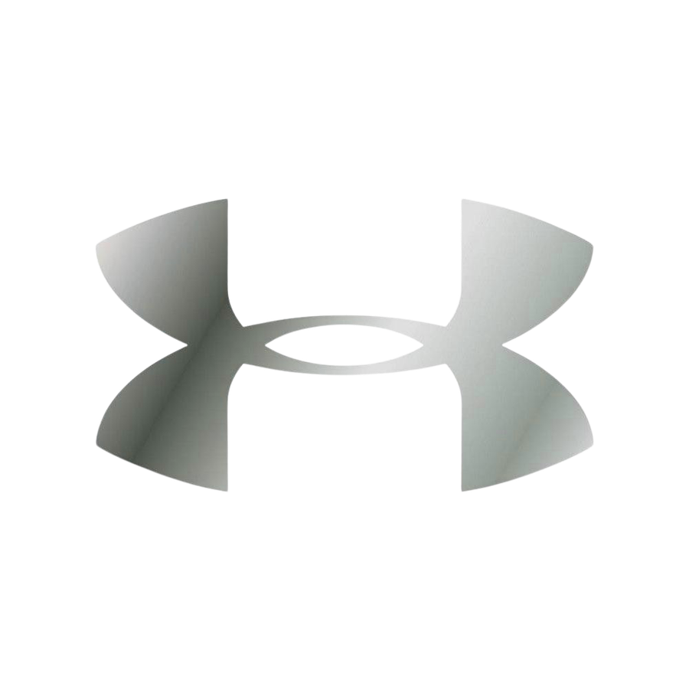
Thank You

